Slide 1
DBSCAN
Density Based Spatial Clustering of Applications with Noise
Authored By
Priyank Lohariwal

Slide 2
Agenda
Motivation
Basic Concepts
Algorithm
Parameter Estimation
Advantages
Disadvantages
References

Slide 3
Motivation
Clusters are dense regions in the data space, separated by regions of lower object density
A cluster is defined as a maximal set of densely connected points
Discover clusters of arbitrary shape

Slide 4
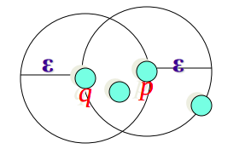
Density Definition
ε-Neighborhood - Objects within a radius of ε from an object.
“High Density” - ε-Neighbourhood of an object containing at least MinPts of objects

Slide 5
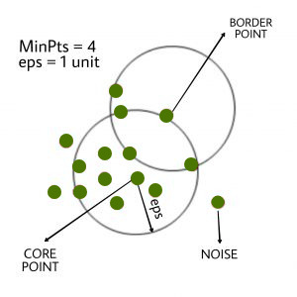
Basic Concepts
Core, Border & Outliers
Core Points - Has more than a specified number of points (MinPts) within Eps - These are points that are at the interior of a cluster
Border Points - Has fewer than MinPts within Eps, but is in the neighbourhood of a core point.
Outlier Points - Point that is neither a core nor a border point

Slide 6
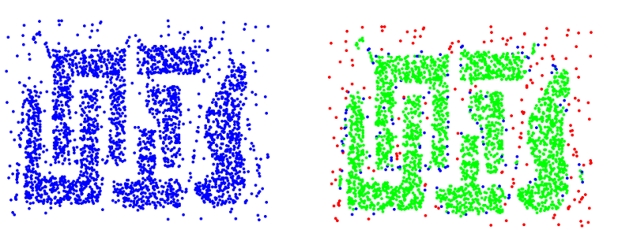
Basic Concepts
Core, Border & Outliers
Original Points
Core, border and outliers

Slide 7
Basic Concepts
Reachability
A point q is directly reachable from p if point q is within distance ε from core point p. Points are only said to be directly reachable from core points.
A point q is reachable from p if there is a path p₁, ..., p_{n} with p₁ = p and p_{n} = q, where each p_{i+1} is directly reachable from p_{i}. Note that this implies that the initial point and all points on the path must be core points, with the possible exception of q.

Slide 8
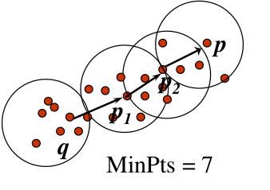
Basic Concepts
Reachability - Examples
A point p is directly reachable from p2
p2 is directly reachable from p1
P1 is directly reachable from q
P <- p1 <- p1 <- q form a chain
p is indirectly reachable from q
q is not reachable from p
Reachability is assymetric

Slide 9
Algorithm
Abstract
Find all the neighbour points within ε and identify the core points.
Take any uninvited core point and create a new cluster with it.
FInd recursively all the reachable points and assign them to the same cluster
Iterate through the remaining unvisited points in the dataset and follow the above procedure
FInally, the points that do not belong to any cluster are outliers or noise

Slide 10
Algorithm
Pseudocode
DBSCAN(dataset, eps, MinPts) {
C = 0 #cluster-index
for each unvisited point P in dataset
mark P as visited
N = getNeighbours(P, eps)
if sizeof(N) < MinPts
mark P as NOISE
else
C = next cluster
expandCluster(P, N, C, eps, Minpts)
}
expandCluster(P, N, C, eps, MinPts) {
add P to cluster C
for each point P' in N
if P' is not visited
mark P' as visited
N' = getNeighbours(P', eps)
if sizeof(N') >= MinPts
N = N U N'
if P' does not belong to any cluster
add P' to C
}

Slide 11
Algorithm
Demonstration

Slide 12
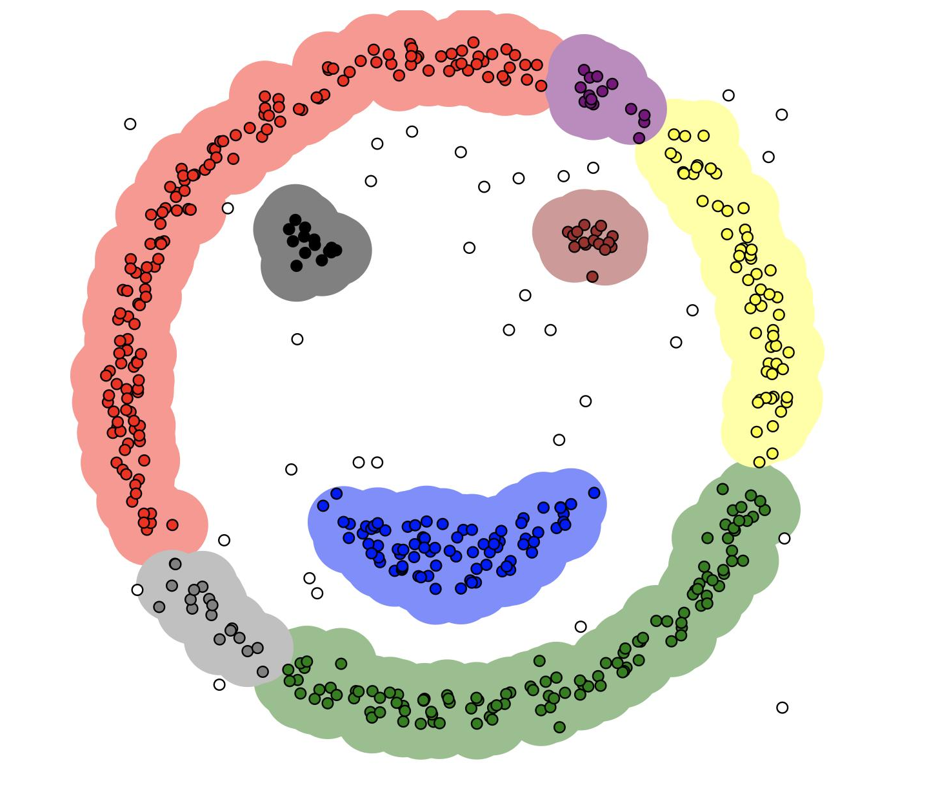
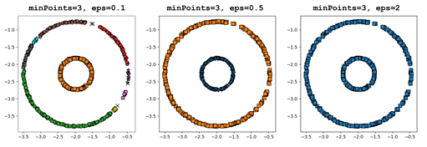
Parameter Estimation
Sensitive to Parameters
MinPts = 6

Slide 13
Parameter Estimation
Determining ε using k-distance graphs
Supposedly, for points in a cluster, their k^{th} nearest neighbors are at roughly same distance
Outliers have the k^{th} nearest neighbour at the farthest distance
Plot sorted distance of every point to its k^{th} nearest neighbour is a k-distance graph
Good values of ε are where this plot shows an “elbow”.
k = minPts - 1

Slide 14
Parameter Estimation
Determining MinPts using dimensions D of the data
Generally, minPts >= D+1
More efficiently, minPts = 2.D
Larger values are usually better for data sets with noise and will yield more significant clusters

Slide 15
Advantages
No need to specify number of clusters
Can find non-linear, arbitrary shaped clusters.
Handle noise points as outliers
Comparatively less number of parameters
Insensitive to the ordering of data points

Slide 16
Disadvantages
Cannot cluster datasets with varying densities
Highly sensitive to parameters
Border points are non-deterministic
Quality depends on the distance measure used. This becomes quite prominent when dealing with high-dimensional data

Slide 17
References
“DBSCAN.” Wikipedia, Wikimedia Foundation, 1 Dec. 2020, en.wikipedia.org/wiki/DBSCAN
“DBSCAN Clustering Algorithm in Machine Learning.” KDnuggets, www.kdnuggets.com/2020/04/dbscan-clustering-algorithm-machine-learning.html
Gao, Jing. “clustering_density.pdf.”, cse.buffalo.edu/~jing/cse601/fa12/materials/clustering_density.pdf

Slide 18
Thank You

